Slide 2
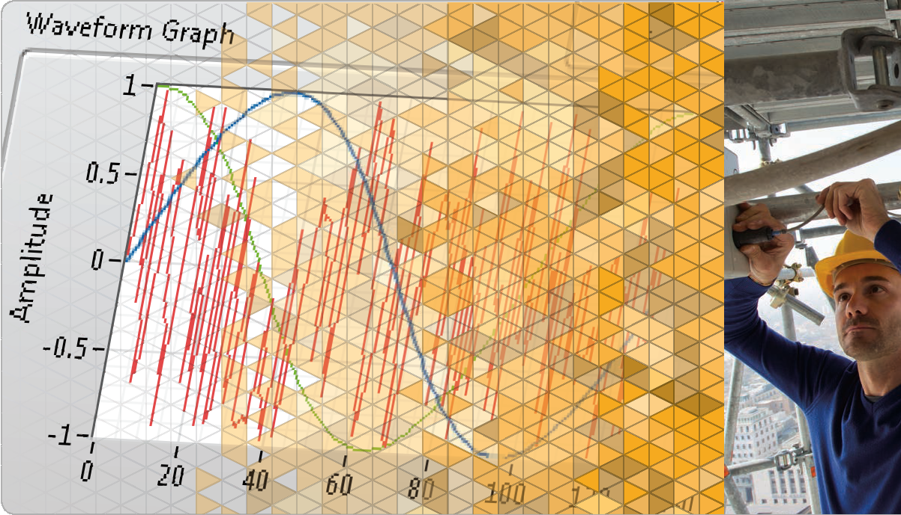
LabVIEW Core 1

Slide 3

Welcome to LabVIEW Core 1
What You Need To Get Started
Computer running Windows XP or later and LabVIEW 2014
NI LabVIEW Student Edition

Slide 4
Welcome to LabVIEW Core 1
Getting the Most Out of This Course
Ask questions!
Experiment with hands-on exercises to understand the methods used
Explore solutions
Implementations explore a possible solution—you may find a better one

Slide 5
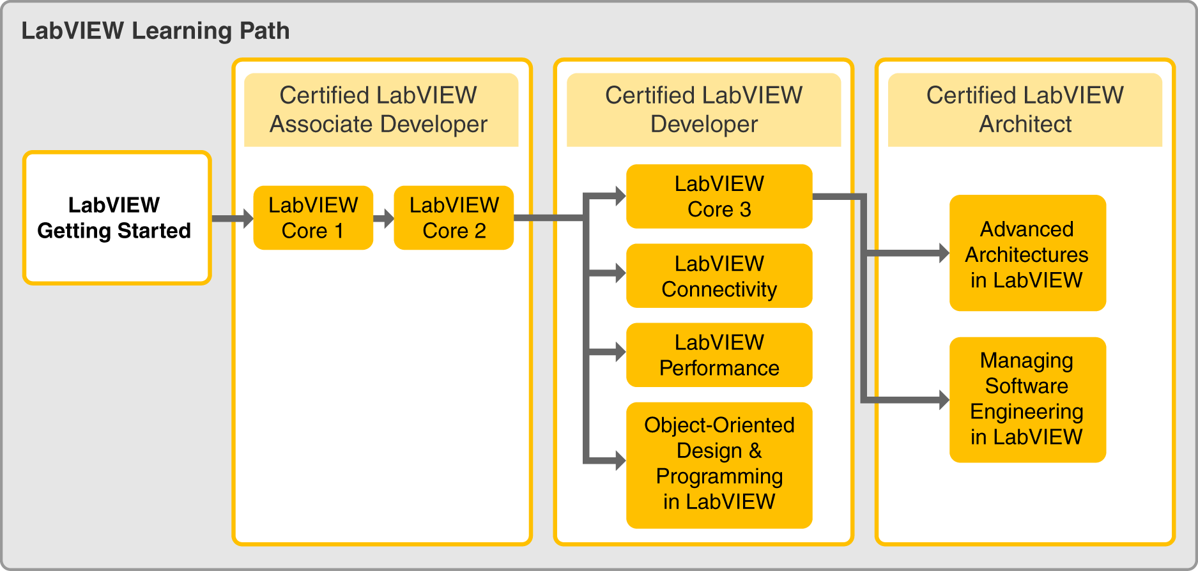
Welcome to LabVIEW Core 1
LabVIEW Certification

Slide 6
Welcome to LabVIEW Core 1
Course Learning Map
Lesson 1
Troubleshooting and Debugging VIs
Lesson 4
Lesson 2
Navigating LabVIEW
Creating Your First Application
Lesson 3
Using Loops
Lesson 5
Modularity
Lesson 6
Creating and Leveraging Data Structures
Using Decision-Making Structures
Lesson 7
Lesson 8
Using Sequential and State Machine Programming
Lesson 9
Acquiring Measurements with Hardware
Accessing Files in LabVIEW
Lesson 10

Slide 7
Lesson 1
Navigating LabVIEW
Recognize the main components of the LabVIEW environment and create a new project and VI.
What is LabVIEW?
Project Explorer
Parts of a VI
Front Panel
Block Diagram
Searching for Controls, VIs, and Functions

Slide 8
A. What is LabVIEW?
Recognize benefits of LabVIEW.

Slide 9
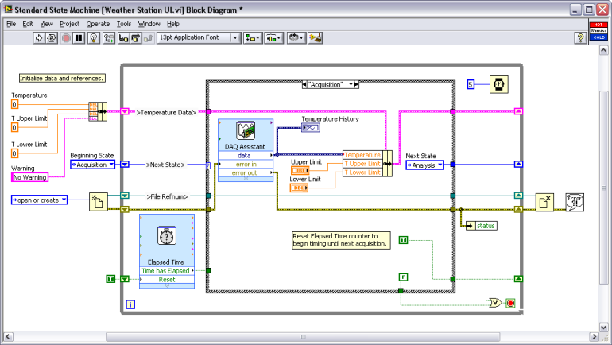
A. What is LabVIEW?
Benefits of LabVIEW
Interfaces with wide variety of hardware
Scales across different targets and OSs
Provides built-in analysis libraries

Slide 10
A. LabVIEW Environment
LabVIEW Language Characteristics
LabVIEW Core 1 Topics
Graphical
Synchronous
LabVIEW Core 2 and Later Topics
Multi-threaded
Dataflow-oriented
Compiled
Multi-platform
Object-oriented
Multi-target
Memory-managed
Event-driven

Slide 11
Activity 1-1
Confidence Activity: Building a VI
Build an application to calculate the product of two numbers.
Notes:
In Class Exercise

Slide 12
B. Project Explorer
Recognize the main components of the Project Explorer.
LabVIEW Files
Project Folders

Slide 13
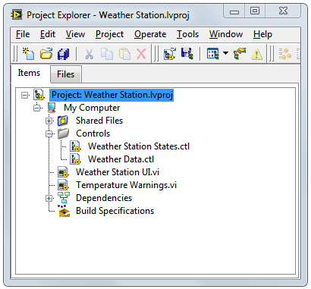
B. Project Explorer
LabVIEW Files
LabVIEW project —.lvproj
Virtual instrument (VI) — .vi
Custom control — .ctl
Notes:
LabVIEW uses many different types of files. In this class you will learn about three different LabVIEW files – LabVIEW projects, VIs, and custom controls.
Historically, LabVIEW programs are called virtual instruments, or VIs, because their appearance and operation imitate physical instruments, such as oscilloscopes and multimeters. Today LabVIEW VIs can be extremely powerful and sophisticated programs with elegant graphical user interfaces.
Later in this course you learn how custom controls can improve maintainability of your LabVIEW application.
LabVIEW projects can also include non-LabVIEW file types. For example, you can include documentation files.

Slide 14
Using the Project Explorer and Creating a VI
Create a project and VI in LabVIEW.
Notes:
In-Class Demo
Start with the Getting Started window and demonstrate selecting the Create Project button and the Open Existing button. Open the Weather Station project (Weather Station.lvproj) solution file to use for this demonstration (Solution 7-1, No HW). Open the Weather Station UI.vi and identify the three parts of a VI – front panel, block diagram, and icon/connector pane.
Add a blank VI, an existing VI, a text file, and remove a file from the project. Be sure to demonstrate that changes made in the Project Explorer window on the Items tab do not reflect how the files are saved on disk. Also, demo the difference between adding/creating virtual folders and adding an auto-populating folder. Demo the difference between the Items tab and the Files tab (The Files tab displays the location of project folders on disk. Project operations on the Files tab both update and reflect the contents of the folder on disk).
NOTE: Do not save the project so that you do not affect your project solution.
Demonstrate the ability to start a VI in LabVIEW the following ways:
From within a project, right-click on My Computer and select New»VI.
With project open, select New VI from File menu.

Slide 15
B. Project Explorer
Adding Folders to a Project
Virtual folder
Auto-populating folder

Slide 16
C. Parts of a VI
Recognize and understand the difference between the front panel and block diagram.

Slide 17
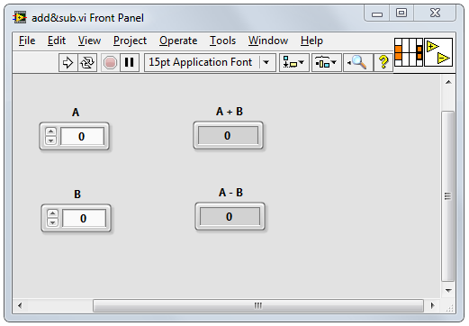
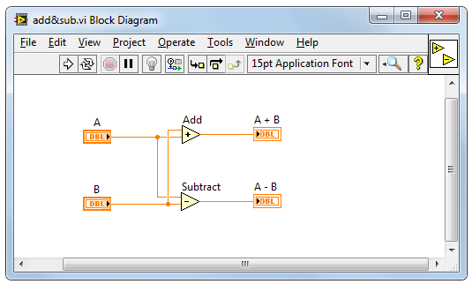
Components of a VI
Icon/Connector pane
Block diagram
Front panel

Slide 18
D. Front Panel
Recognize the components and functionality of the Front Panel window and select appropriate controls and indicators.
Front Panel Window Toolbar
Controls and Indicators
String, Boolean, and Numeric Data Types
Front Panel Object Styles

Slide 19
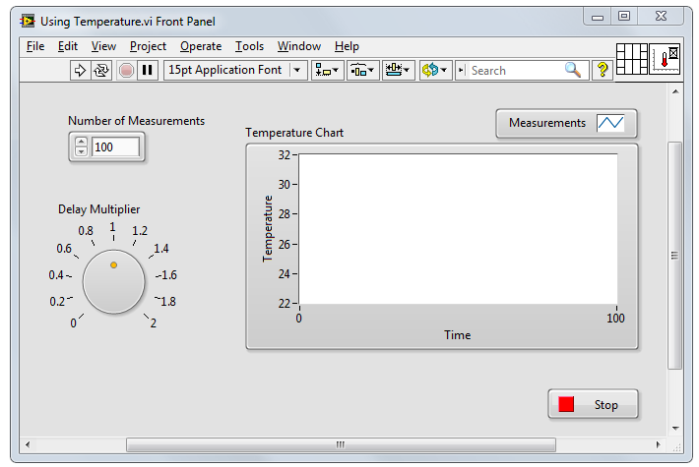
D. Front Panel
Front Panel Window Toolbar

Slide 20
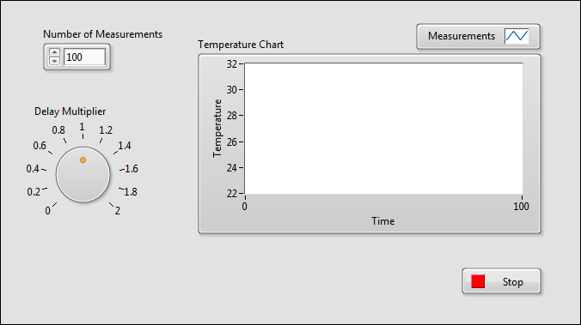
D. Front Panel
Controls and Indicators
Controls: Inputs
Indicators: Outputs
Notes:
Identify controls and indicators on this front panel.
In the next few slides, you learn basic data types: numerics, strings and Booleans.
You learn representation, mechanical action, and string display types in the next lesson.

Slide 21

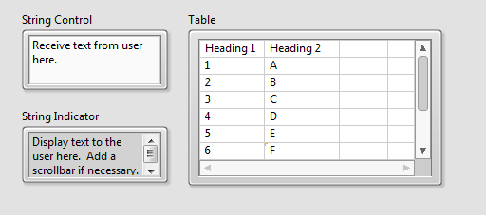
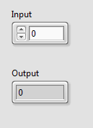
D. Front Panel
String, Boolean, and Numeric Data Types
Boolean
control
Boolean
indicator
Numeric control
Increment/Decrement buttons
Numeric indicator
Notes:
The numeric data in a control or indicator can represent numbers of various types, such as integer or floating-point.

Slide 22
Activity 1-2
Select Front Panel Objects
For each scenario, determine the appropriate data type and whether the front panel object should be a control or indicator.
Notes:
In-Class Exercise

Slide 23
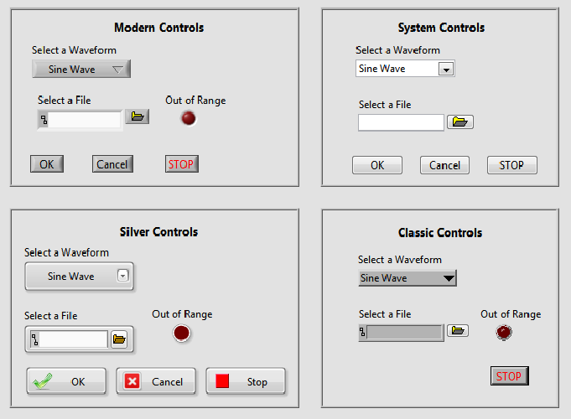
D. Front Panel
Front Panel Object Styles
Notes:
LabVIEW has different control palettes with objects for building user interface, including the Modern, Silver, Classic, and System palettes.
The controls and indicators on the Silver palette are the newest to LabVIEW. They provide a rich user interface. Because of the added glyphs, the Silver objects tend to be a little larger than other styles.
Use objects from the System palette when you want a dialog that matches your operating system. The System controls (also known as dialog controls) change appearance depending on which platform you run the VI. For example, when running on a Mac OS, the controls adapt a different color and appearance than they have on a Windows OS so that they match the appearance of the Mac OS system.
Not all palettes have the same options. For example, the System palette does not have a LED.
Similarly, if you use Quick Drop, you will notice multiple options. The new Silver controls will have “Silver” in the parentheses.

Slide 24
E. Block Diagram
Recognize features of the Block Diagram and be able to select functions.
Block Diagram Toolbar
Components of a Block Diagram
Express VIs
Node Appearance
Wires
Context Help and LabVIEW Help
Examples

Slide 25
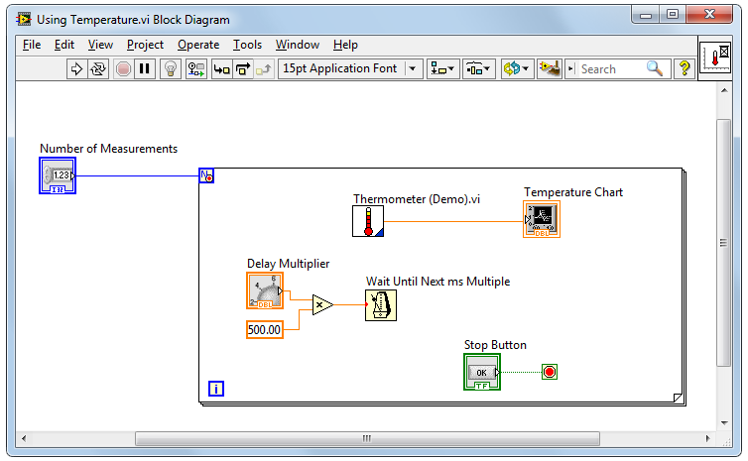
E. Block Diagram
Block Diagram Toolbar
Notes:
Run, Run Continuously, Abort Execution, Pause, Highlight Execution, Retain Wire Values, Step Into, Step over, Step Out, Text Settings, Align Objects, Distribute Objects, Reorder, Clean Up Diagram
Students learn about debugging tools in the next lesson. Use next slide to learn about different objects on block diagram.
Click the Run button to run the VI. LabVIEW compiles the VI, if necessary. You can run a VI if the Run button appears as a solid white arrow. If the Run button appears broken, the VI contains edit-time errors. Students learn about fixing edit-time errors in the next lesson.

Slide 26
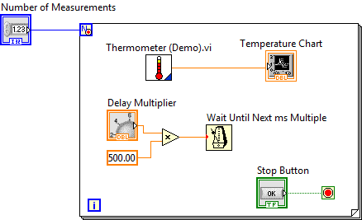
Components of a Block Diagram
Notes:
Objects on the block diagram include terminals and nodes. You build block diagrams by connecting the objects with wires. The color and symbol of each terminal indicate the data type of the corresponding control or indicator. Constants are terminals on the block diagram that supply fixed data values to the block diagram.
Nodes are objects on the block diagram that have inputs and/or outputs and perform operations when a VI runs.

Slide 27
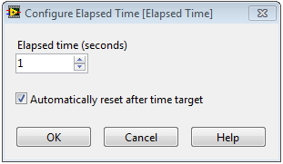
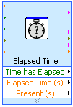
E. Block Diagram
Express VIs

Slide 28
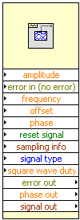


E. Block Diagram
Node Appearance
Icon
Expandable Node

Slide 29

E. Block Diagram
Wires
Wires transfer data between block diagram objects.
A broken wire:
Floating-point
Integer
String
Boolean
Scalar
1-D Array
2-D Array

Slide 30
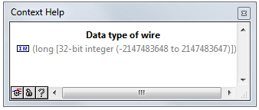
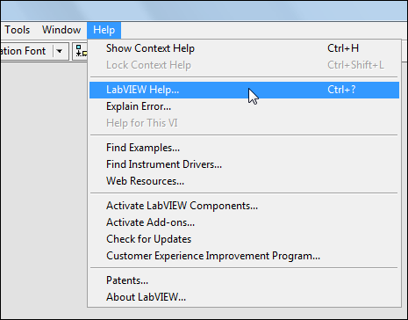
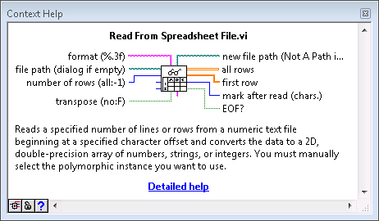
Context Help and LabVIEW Help

Slide 31
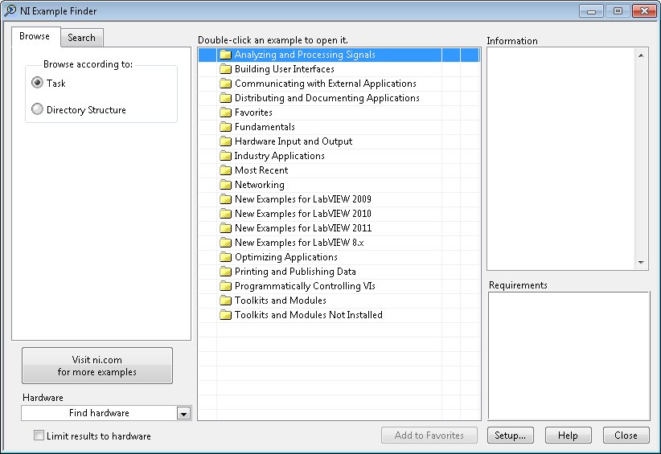
E. Block Diagram
Examples
Use NI Example Finder (Help»Find Examples) to browse and search hundreds of installed examples.
Notes:
Use the NI Example Finder to search all installed examples and examples located in the NI Developer Zone on the web.
Modify any example VI to fit an application, or copy and paste from an example into a VI that you create.
Methods of accessing the NI Example Finder:
Select Help»Find Examples
Click the Find Examples link in the Getting Started window
You can access examples using the Open example and Find related examples buttons located at the bottom of certain VI and function reference topics in the LabVIEW Help. Click the Open example button to open the example VI to which the topic refers. Click the Find related examples button to open the NI Example Finder and display related example VIs.

Slide 32
Exercise 1-1
Exploring a VI
Identify the parts of an existing VI.

Slide 33
Exercise 1-1
Exploring a VI
What are constants and when should you use them?
What are free labels and when should you use them?

Slide 34
F. Searching for Controls, VIs, and Functions
Find the controls, indicators, and functions you need.
Palettes
Quick Drop
NI Global Search

Slide 35
Searching for Controls, VIs, and Functions
Using the palettes, Quick Drop, and Global Search demonstrate searching for controls, VIs, and functions.

Slide 36
Exercise 1-2
Locating Controls, Functions, and VIs
Learn to use the palettes and search for controls, functions and VIs.

Slide 37
Exercise 1-2
Locating Controls, Functions, and VIs
Why would you want to add a function to the Favorites category in the Functions palette?
Why would you use the Quick Drop dialog box instead of the Search button on the Controls and Functions palettes?

Slide 38

Activity 1-3
Lesson Review
Refer to the participant guide to answer questions about what you have learned in this lesson and then discuss the answers as a group.

Slide 39
Lesson Review
What are the three parts of a VI?
Front panel
Block diagram
Project
Icon/Connector pane
Notes:
The answer is a, b, and d.

Slide 40
Lesson Review
What are the three parts of a VI?
Front panel
Block diagram
Project
Icon/Connector pane
Notes:
The answer is a, b, and d.

Slide 41
Lesson 2 Creating Your First Application
Use Express VIs to produce a project and simple VI that acquires and analyzes data and then displays the results.
Dataflow
LabVIEW Data Types
Tools for Programming, Cleaning and Organizing Your VI
Building a Basic VI

Slide 42
A. Dataflow
Recognize characteristics of dataflow on the block diagram.

Slide 43

A. Dataflow
Key Points of Dataflow
Node executes only when all input data are available.
Node supplies data to the output terminals only when it is finished executing.
Notes:
When a node executes, it produces output data and passes the data to the next node in the dataflow path.
The movement of data through the nodes determines the execution order of the VIs and functions on the block diagram.
LabVIEW does NOT use a control flow program execution model like Visual Basic, C++, JAVA, and most other text-based programming languages. In a control flow model, the sequential order of program elements determines the execution order of a program.

Slide 44
Activity 2-1
Exploring Dataflow
Identify dataflow execution order in the following block diagrams.
Notes:
The diagrams and discussion questions for the next slides are also available in the student exercise manual.

Slide 45
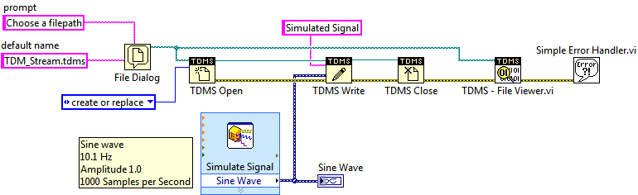
A. Dataflow
Dataflow: Example A
Notes:
Use this diagram to discuss dataflow. Focus on the wiring dependencies and data flow between nodes. Students should not to be concerned with specific data types nor the functionality of actual nodes for this exercise.
Discussion areas:
Which node executes first? Last?
Is there any dependency between the File Dialog node and the Simulate Signal node?
Since the green path wire is wired from the File Dialog to the TDMS – File Viewer.vi, can the TDMS – File Viewer.vi execute before the TDMS Close functions? Point out that all the inputs have to be available before the node can execute.
Should a well-designed block diagram flow in a particular direction? Yes, a well-designed block diagram typically flows from left to right. This makes it easier to see the flow of data on the block diagram.

Slide 46
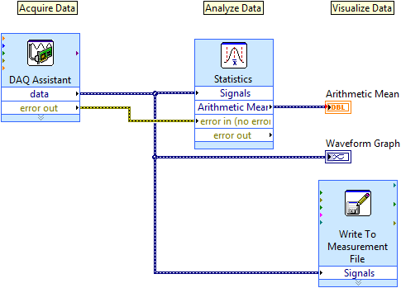
A. Dataflow
Dataflow: Example B
?
Notes:
Either the Statistics Express VI or the Write to Measurement File Express VI executes last or they execute in parallel. The DAQ Assistant Express VI cannot execute last because both the Statistics Express VI and the Write to Measurement File Express VI are dependent on the data signal from the output of the DAQ Assistant Express VI. It is possible to have simultaneous operations.
You may want to open a VI and show students what is happening in this diagram using execution highlighting.

Slide 47
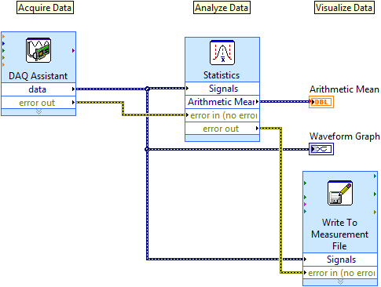
A. Dataflow
Dataflow: Example C
?
Notes:
Now that there is a new yellow error wire, which express VI executes last?
The Write to Measurement File executes last because of dependencies on the DAQ Assistant and Statistics Express VIs.

Slide 48
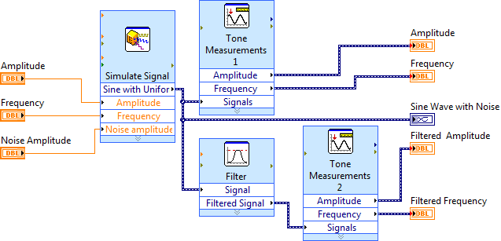
A. Dataflow
Dataflow: Example D
?
Notes:
Either one of the Tone Measurement Express VIs can execute last. Even though the Tone Measurements 2 Express VI has an extra dependency on the Filter Express VI, the Filter Express VI might execute before the Tone Measurements 1 Express VI allowing the Tone Measurements 2 Express VI to execute before the Tone Measurements 1 Express VI.

Slide 49
B. LabVIEW Data Types
Recognize the different data types and how they relate to front panel objects.
Accessing Object Properties
Boolean Data
Numeric Data Representations
Strings
Enums
Other Data Types

Slide 50
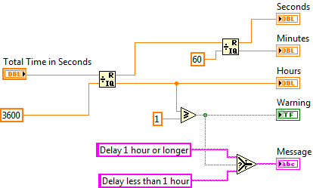
B. LabVIEW Data Types
Terminals and LabVIEW Data Types
Terminals visually convey information about data type.
Notes:
Terminal colors, text, arrow direction, and border thickness all provide visual information about the terminal.
For example, Orange represents floating point numbers. DBL indicates a double-precision floating point number.
Terminals with thick borders with arrows on the right are control terminals. Terminals with thin borders with arrows on the left are indicator terminals.

Slide 51
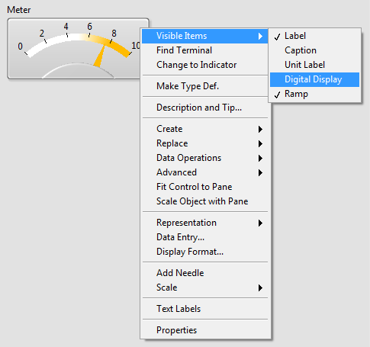
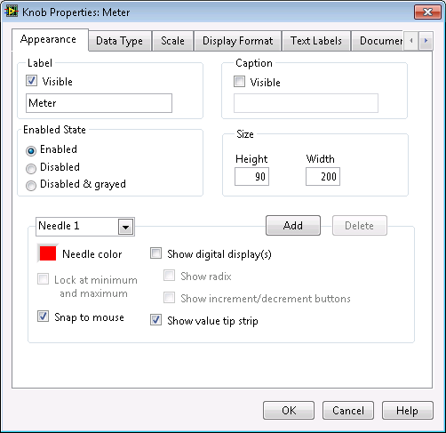
Accessing Object Properties

Slide 52


B. LabVIEW Data Types
Boolean Data
Notes:
Use Boolean controls and indicators to enter and display Boolean (TRUE/FALSE) values. For example, if you are monitoring the temperature of an experiment, you can place a Boolean warning light (LED) on the front panel to indicate when the temperature exceeds a certain level. To properly use Boolean values they should only be used to represent items that can have only two values: yes/no, true/false, on/off, etc

Slide 53
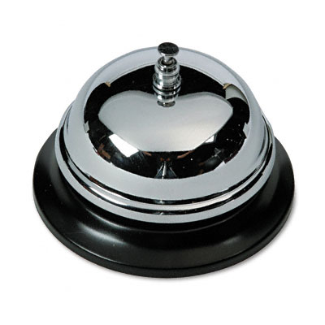


Mechanical Actions of Boolean Controls
Notes:
Point out that in everyday life we interface with many Boolean switches and buttons. These switches and buttons have different mechanical behaviors.
Light switches change state when the switch is flipped. The state stays the same until you flip the switch again.
Buzzers and door bells change state on a button press. They change back when the button is released.
Mouse clicks and keyboard presses have a latch behavior. They change state on a button release. Furthermore, the key press or mouse click only takes effect when read by the system. When your computer system is sluggish, we sometimes see a delay in processing a mouse click or key press.

Slide 54



Numeric Data Representations
Notes:
Various data type representations:
Floating-point
Unsigned integers
Signed integers
Conversion/Coercion
For this slide, talk about the difference between unsigned integers, signed integers, and floating point.
Integers represent whole numbers.
Unsigned integers are non-negative values.
Signed integers can be positive, negative, or zero.
Students learned about the numeric, Boolean and string data types in Lesson 1. Now, they learn about implementing these data types, such as representation, Boolean action, and string display type. They also learn a couple new data types: Enum and dynamic.

Slide 55
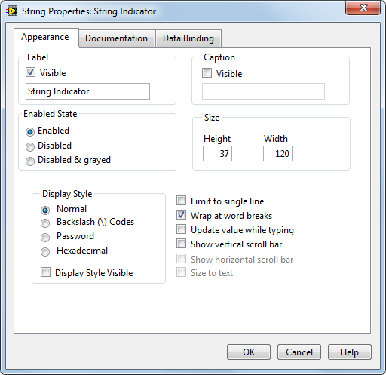

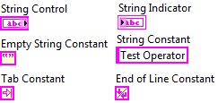
B. LabVIEW Data Types
Strings
Notes:
Uses for strings:
Creating simple text messages.
Controlling instruments by sending text commands to the instrument and returning data values in the form of either ASCII or binary strings which you then convert to numeric values.
Storing numeric data to disk. To store numeric data in an ASCII file, you must first convert numeric data to strings before writing the data to a disk file.
Instructing or prompting the user with dialog boxes.

Slide 56
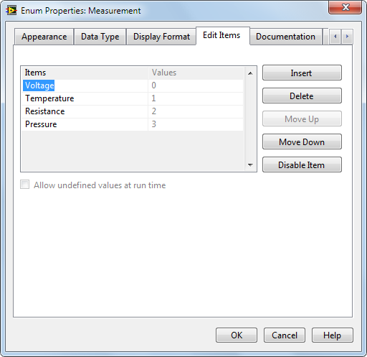

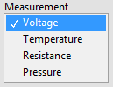

Enums
Notes:
Enums are useful because they make strings equivalent to numbers, and it is easier to manipulate numbers than strings on the block diagram.
The data type of the enum terminal is blue, showing that the enum is passing an integer value.

Slide 57
B. LabVIEW Data Types
Other Data Types
Type | Terminal | Description
Dynamic |  | Stores the information generated or acquired by an Express VI
Path |  | Stores the location of a file or directory
Waveform |  | Carries the data, start time, and dt of a waveform
Notes:
How might a Path data type differ from a String data type?
Although it is easy to convert a Path to a String, it is best to use a Path data type when working with a location of a file or directory. Using the Path data type, LabVIEW can handle the folder specifiers (for example, a backslash on Windows).

